Slide 1
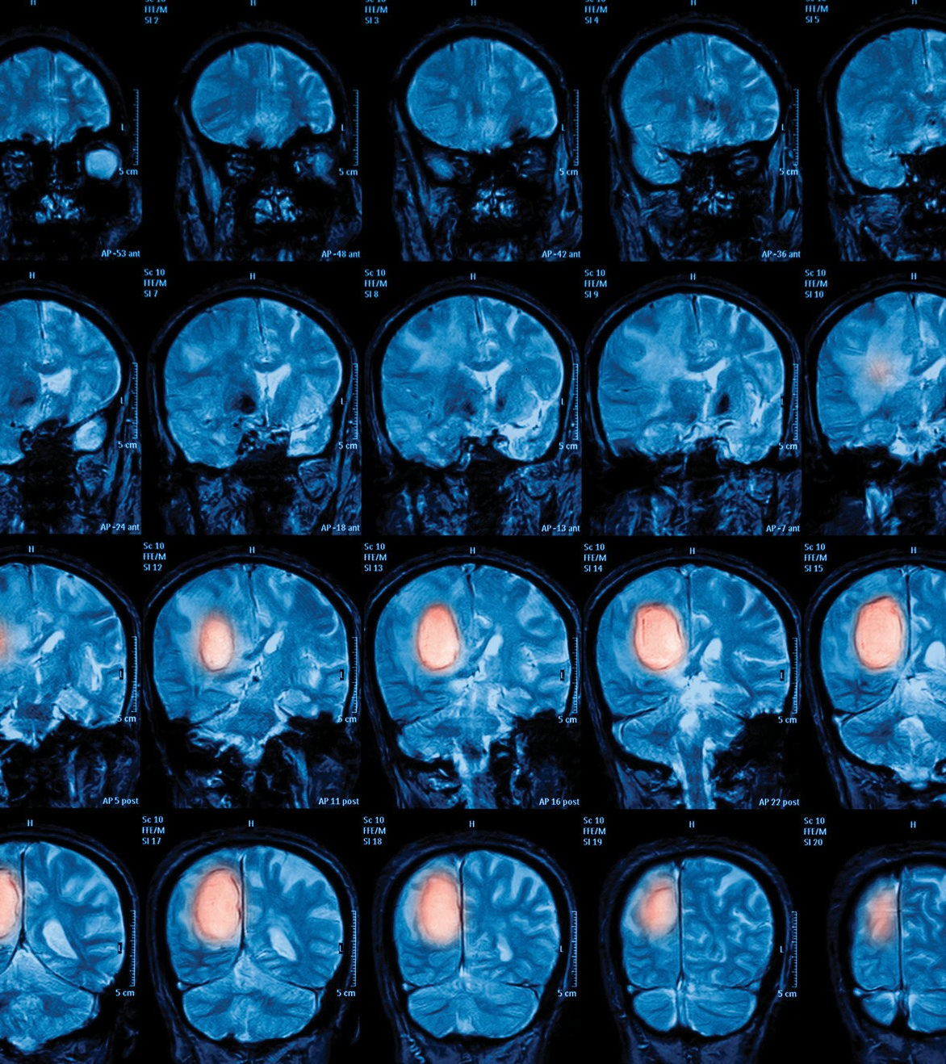
Brain Tumor Classification using a CNN Model
Gayathri Ganesh

Slide 2
Objective
Build a CNN model to classify whether a subject has Brain Tumor or not
Replace human intervention of large datasets
Reduce events of misdiagnosis in patients

Slide 3

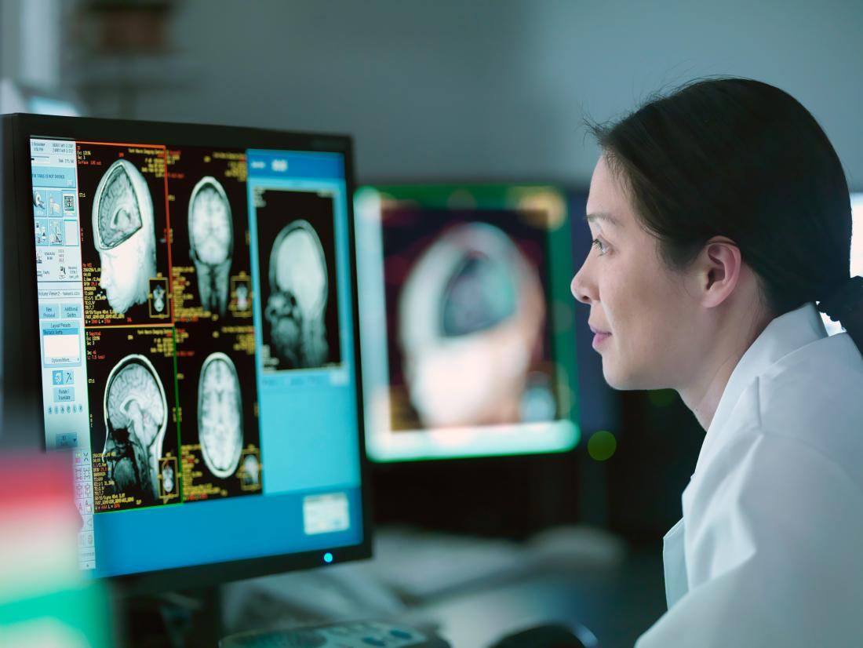
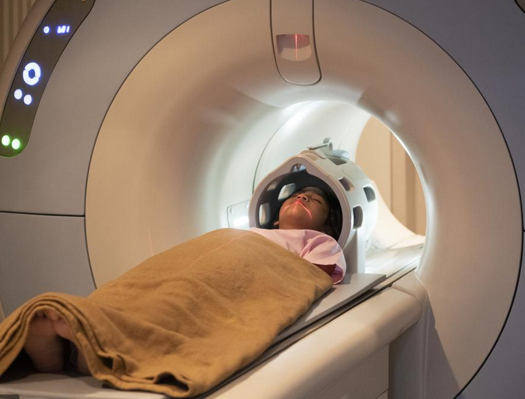


Target Audience
Neurologists
Patients
Medical Diagnostic staff
Radiologists
Research students

Slide 4
PROPOSED METHOLOGY
Analyze the datasets, MRI brain scans, perform data augmentation if necessary.
A VGG-16 model architecture is proposed, to train this binary classification problem.
For Data Visualization, the 3 categories of brain tumor, will be analyzed and tumors will be masked.

Slide 5
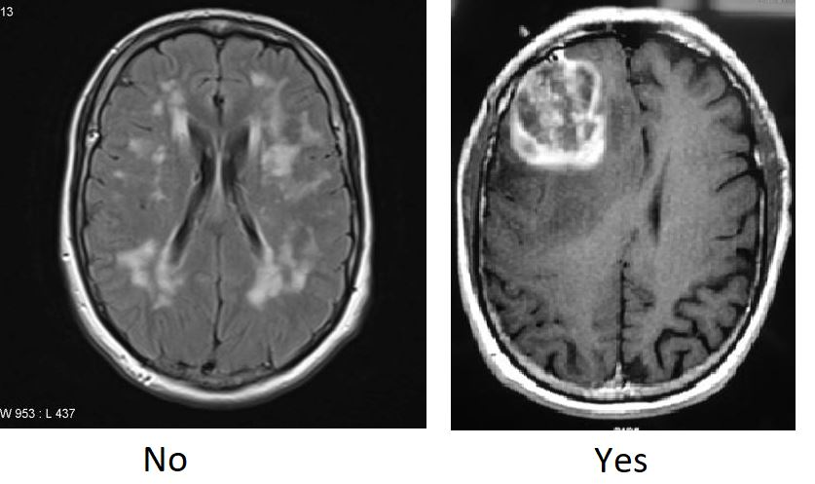
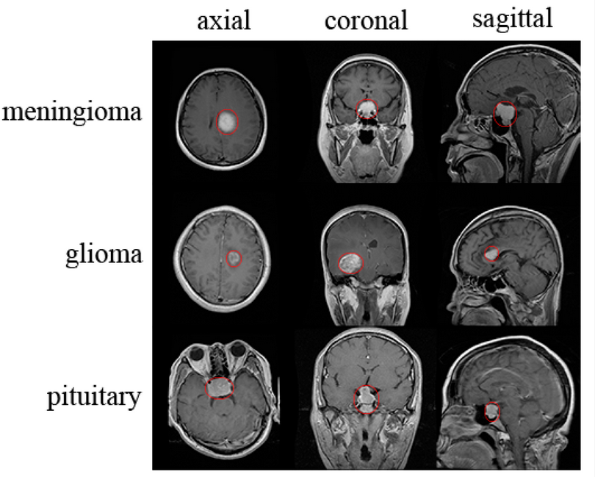
Dataset
Description
1. Kaggle Dataset – ‘Brain MRI Images for Brain Tumor Detection’
SIZE : 8 MB
No. of subjects : 253
‘No’ Tumor - 93 slices
‘Yes’ Tumor - 154 slices
2. Cheng, J. Brain Tumor Dataset – Publicly available on Figshare
This dataset contains 3064 T1-weighted contrast-enhanced images from 233 patients with 3 kinds of brain tumor:
meningioma - 708 slices
glioma - 1426 slices
pituitary tumor - 930 slices

Slide 6
Technology stack
Datasets (Kaggle and Figshare) as images (JPG format)
Google Colaboratory for running Python scripts
CNN model - VGG16 (Deep learning libraries like TensorFlow and Keras)

Slide 7
Existing vs. PROPOSED model
VGG-16 – a relatively new CNN model used
Higher accuracy than existing models
Transfer Learning concept used

